Slide 1
Week 4 Lecture
By Seamus Herlihy & Sofia Furda

Slide 2

Dignity Experiment
In 2014, OkCupid made a blog post about experiments they had done on their users
“If you use the Internet, you’re the subject of hundreds of experiments at any given time, on every site. That’s how websites work.”
They were trying to figure out if their algorithm was working

Slide 3
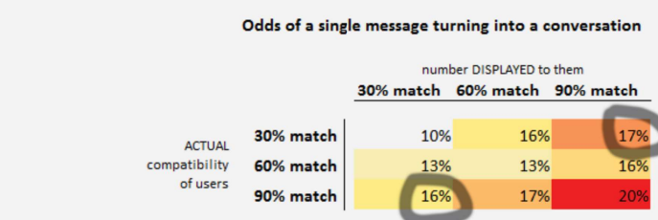
Dignity Experiment
OkCupid was also trying to figure out what effect users compatibility had on their likelihood of turning a match into a lengthy conversation
To do this, they showed some of their users fake compatibility percentages to see if there was a placebo effect
They found that there was
“The mere myth of compatibility works just as well as the truth”

Slide 4

Dignity Experiment
There were a lot of negative reactions
People expressed a loss of trust and fear of being manipulated
Others defended it saying that the CEO just wanted to provide a better experience for the app’s users
What is dignity?

Slide 5
Defining Dignity
Philosophical Negative/Protective Definition:
Based on philosopher Kant's principle: “Treat humanity, whether in your own person or in the person of any other, always as an end and never merely as a means.”
In simpler terms: People should not be treated only as tools or instruments to achieve someone else's goals.
Dignity is not being treated as a means to an end
This protects against exploitation, commodification, and being treated as replaceable or disposable.
Sofia

Slide 6
Defining Dignity
Philosophical Positive/Enabling Definition:
Dignity is also about the right to accountability and responsibility for one's own actions.
It's the insistence on not being treated as a child or as incompetent.
It's the right to make your own decisions and be held responsible for them.
Dignity is taking responsibility for your actions.
Sofia

Slide 7
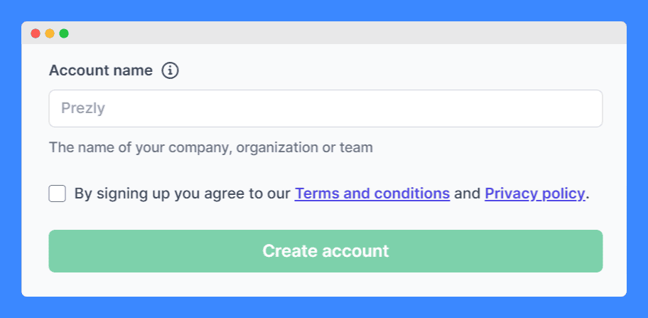
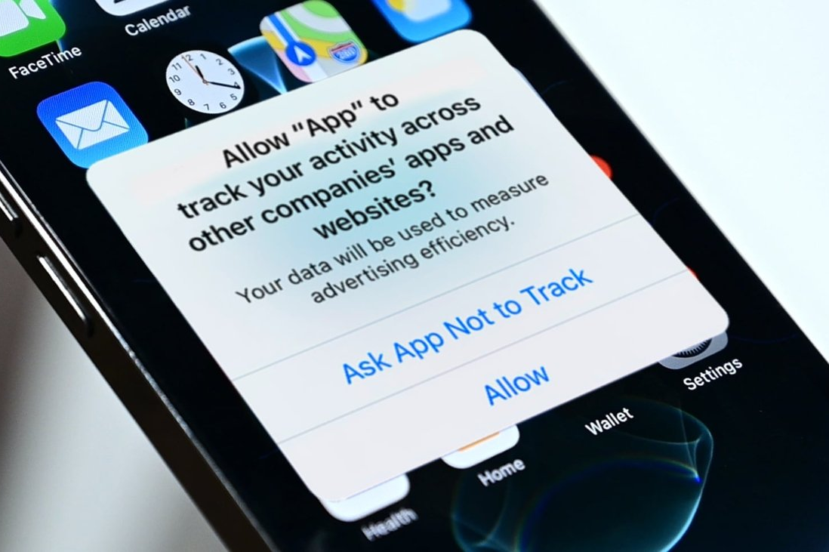
Terms and Conditions | App Tracking
Are users dignified by the interactions of agreeing to terms and conditions without reading them?
Are users dignified by the interaction of agreeing to app tracking notifications without fully understanding what they consent to?
Sofia

Slide 8
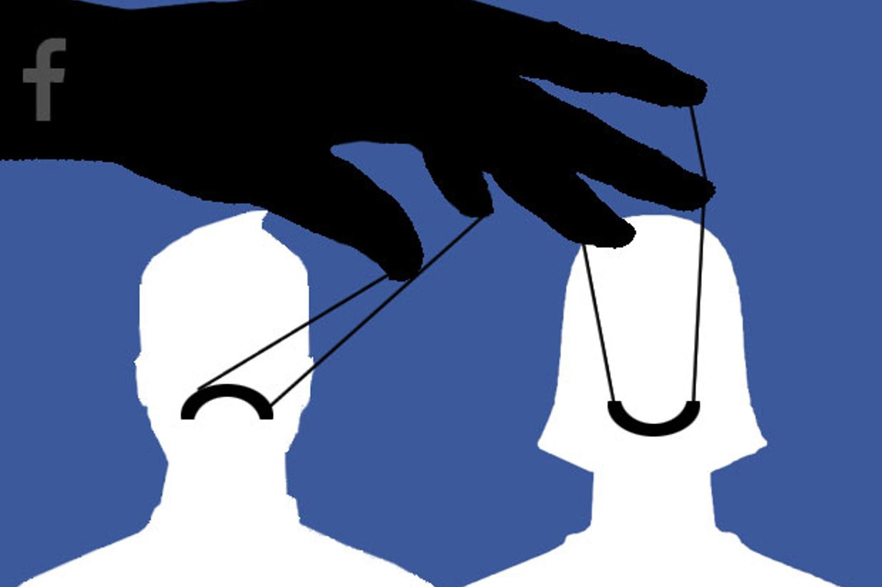
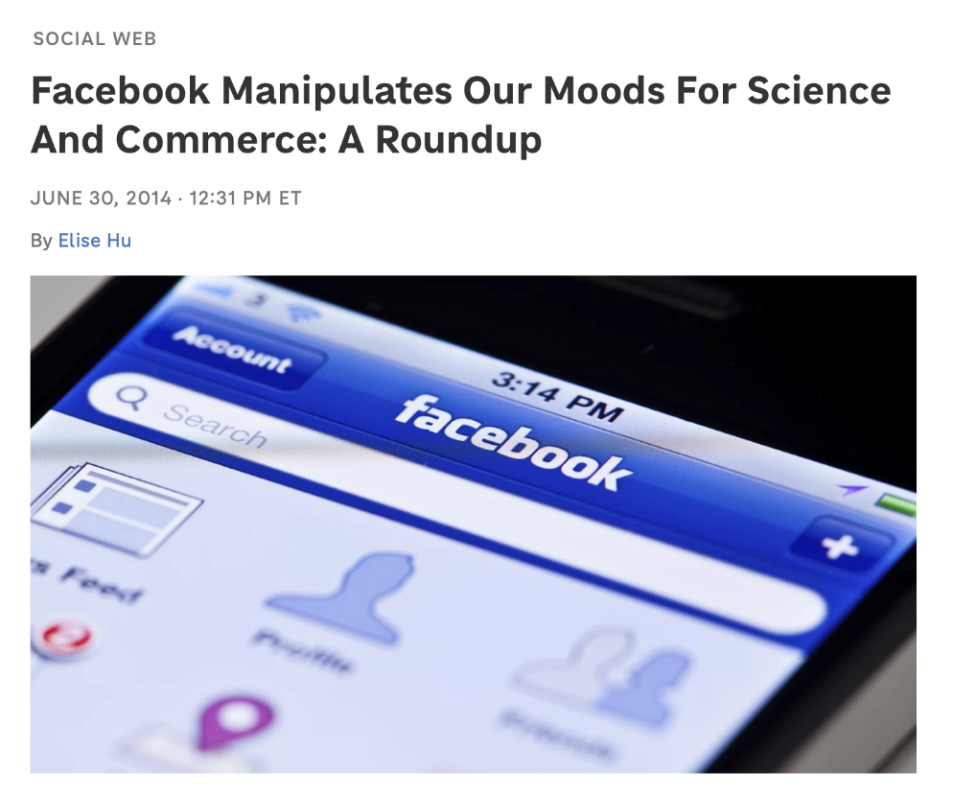
Facebook’s Emotional Contagion Experiment
Sofia
Experiment: Facebook altered users' feeds to show more happy or sad content.
Findings: Users responded with similar emotional tones in their own posts.
Implications: Demonstrates Facebook’s ability to shape emotions and opinions.
Ethical Concern: Users were treated as test subjects without consent.
Dignity Violation: People were used as means to an end rather than respected as individuals.

Slide 9
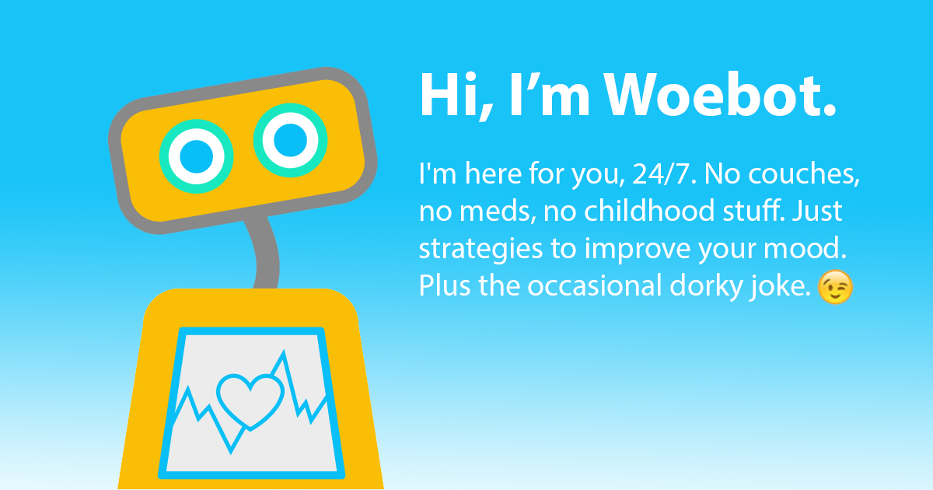
Mimetic AI and Woebots
Mimetic AI mimics specific individuals, unlike general AI.
Woebot Dilemma: AI chat agents mimic therapists for lonely elderly patients.
Ethical Question: Should patients be told the truth if AI improves their well-being?
Arguments Against: AI devalues human language and reduces people to tools.
Counter Arguments: AI may improve health and autonomy, but does it justify deception?
Sofia

Slide 10
Dignity V.S. Autonomy
Dignity Argument: Balances personal freedom, autonomy, and happiness.
Autonomy vs. Dignity: Which is more important?
Kant's View: Life without dignity is not life at all.
Dilemma: Should we lie to achieve positive outcomes like health or happiness?
Truth vs. Lies: Should we tell patients about the Woebots true nature, even if it reduces effectiveness?
Sofia

Slide 11


Are AI Weapons Dignified?
Does dignity ethics preclude or sanction AI warfare?

Slide 12
Are AI Weapons Dignified?
Dignity of human life argument against AI weaponry: Decisions involving human life should remain human judgement; only we understand the dignity of life
Perhaps AI weaponry makes life “cheaper”; but is there any difference between AI and bombs or landmines?
Accountability and responsibility argument against AI weaponry: Who will be held responsible for acts of war committed by AI?

Slide 13
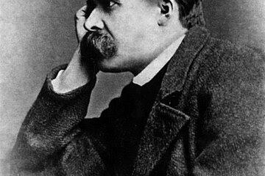
Dignity vs. Happiness
In Twilight of the Idols, Nietzsche argues that dignity can be more important than happiness
Should OkCupid be allowed to infringe upon our experience of dignity in order to increase happiness?
Happiness is easier to measure than dignity

Slide 14
Where does dignity come from?
Body?
Intelligence?
Intentions?
Self-consciousness?
What is it about us that makes us feel dignity or indignity?

